Slide 1
University of Diyala College of Engineering Department of Communications Engineering
Satellite Communications
By:
Dr. Majidah Hameed Majeed

Slide 2
Lecture # 3

Slide 3
Chapter two Communication satellite link budget
Note add additional sections
2.1 Introduction
The first step in designing a satellite network is performance of a satellite link budget analysis. The link budget will determine what size antennae to use, power amplifier requirements, link availability and bit error rate (BER).
What is a link budget?
Simply put, a link budget is the sum and total of all gains and losses in the radio connection between two parties from end to end, including antenna's, feed lines and the path between the antenna's, but also the relevant portions of the transmitter and the receiver, as well as miscellaneous gains and losses.
A link consists of three parts as shown in fig. (2.1)
For a line-of-sight radio link, the link budget might look like this: Prx = Ptx + Gtx - Ltx - Lfs - Lm + Grx - Lrx

Slide 4
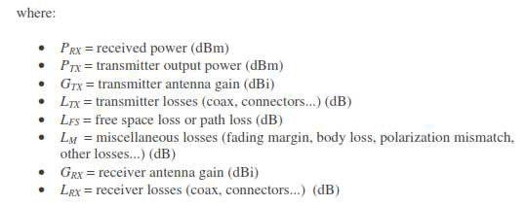
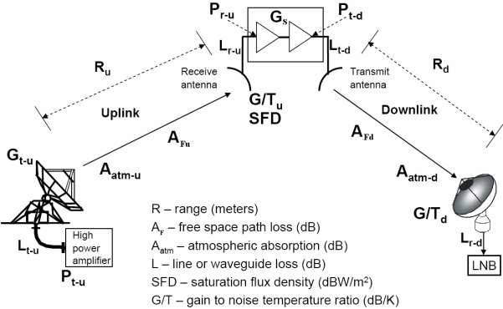
Fig 2.1 Configuration of link
In order to add all these factors, all power levels must be specified in dBm or dBW. For example, if the transmitter puts out 10 Watts (or 10,000 mW) its power is 10,000 times the reference power of 1 mW. Since 10,000 is ten to the
fourth power, this gives us a transmitter power of 40dBm. To clarify:

Slide 5
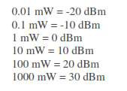
2.2 Main Link Parameters
Antenna gain EIRP
Free space loss Atmospheric absorption loss
Receiver noise power density
Antenna noise Noise temperature Noise figure
Equivalent input noise temperature G/T
2.3 Antenna gain
Is the most important antenna characteristic in link calculations? The gain of parabolic antennas that are often used in satellite communications is
where η is aperture efficiency (50-70%),D is antenna diameter, λ is wavelength

Slide 6
2.4 EIRP
EIRP = Effective isotropic radiated power
EIRP is a product of transmit antenna gain (Gt) and transmitter output power (Pt), EIRP = PtGt
EIRP variation is typically due to antenna thermal distortion, satellite attitude
instabilities, atmospheric disturbance (i.e. rain) and unit thermal and aging effects.
Example:
Pt = 100 W = 20 dBW, Gt = 1000 = 30 dBi
The signal power also diminishes as it propagates to the earth and this is called the “free space loss”.
Example :
(a) An earth station transmits with 10 watts. Its antenna has a gain of 50 dB What is it EIRP?
Solution:
2.5 Basic transmission theory

Slide 7
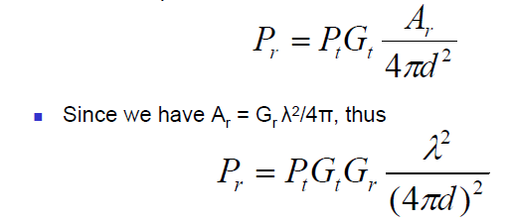
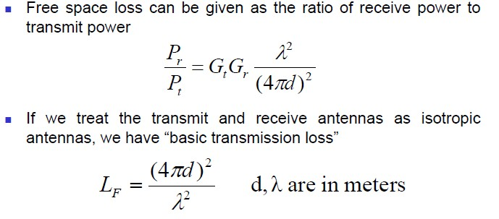
A basic quantity in link budget is propagation loss in free space.
In a satellite link, it is assumed that transmit and receive antennas face each other but are separated by a sufficient distance d [m] in free space.
Gains of the transmit and receive antennas: Gt and Gr; Effective
area of receive antenna Ar; Transmit power Pt; Wavelength λ
Power density at the reception point: pd = Pt Gt / 4π𝑑²
= flux density
Pr = Pd . Ar

Slide 8
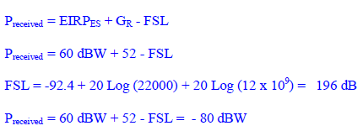
The link equation can be separated into three terms associated with the transmitter, receiver, and free space( path loss ) , respectively.
Then
Pr = Pt Gt Gr / LF
In decibel notation, the equation becomes
The received power in dBW is therefore given as the sum of the transmitted EIRP in dBW plus the receiver antenna gain in dB minus a third term, which represents the free-space loss in decibels.
Normally, the frequency rather than wavelength will be known, and the substitution
λ = c/f
Where c = 3*10^8 m/s with frequency in megahertz and distance in kilometers,
Example :
The earth station has an EIRP of 60 dB and the satellite antenna has a gain of 52 dB at 12 GHz . what is the received power at the satellite.
Solution :

